Slide 1
Battle Simulator
Shir0dev_

Slide 2

Roles
Solo Developer

Slide 3
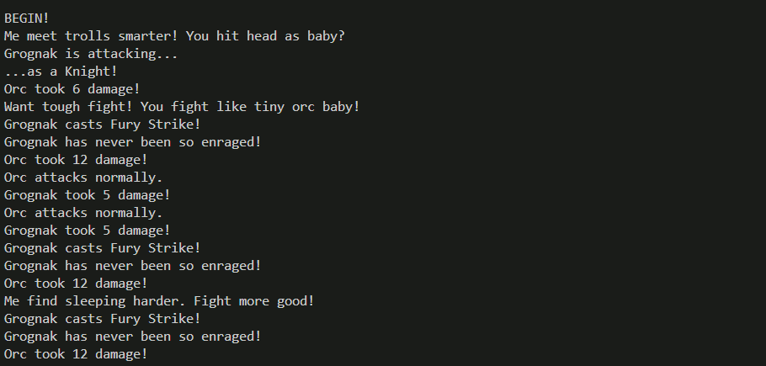
Highlights

Slide 4
Lessons Learned
Time Management
Abstractifying
Component-Based Development

Slide 5
Future Possibilities
Better UX
Customizable Abilities
Choice System
Dynamic Combat (not scripted)

